Slide 1
ICT TOOLS & SYSTEMS

Slide 2
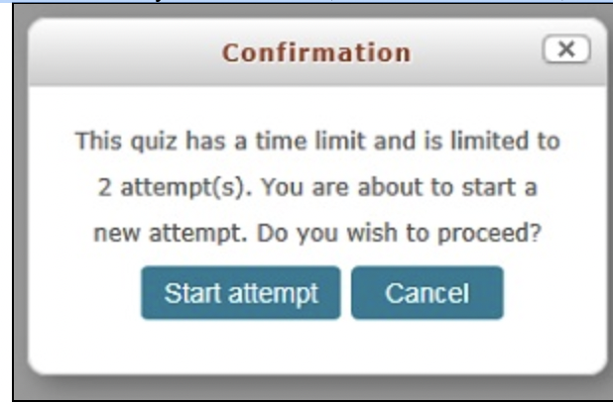
Taking a quiz in Moodle
Online quizzes, tests, and exams are generally found under the course they are for.
1. To take a quiz, click on the link for the test in the appropriate section of your Moodle site, review the directions, and click Preview quiz now.

Slide 3
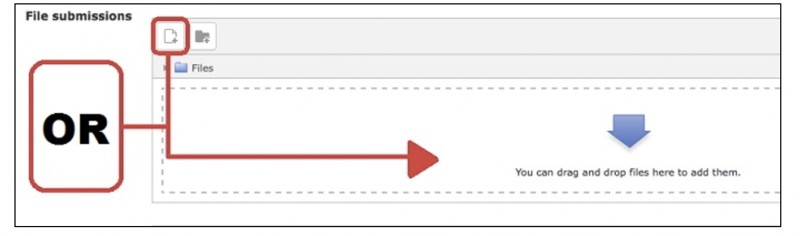

UPLOADING ASSIGNMENT
1.If you have to upload a file into Moodle, click on the assingment you need to submit. These activities can be identified by this icon:
2. This will bring you to the Submission Staus page where you click on Add Submission.
3. Click on "Add.." then click Browse then Upload this File. You can also drag and drop your file into the area below then Save Changes.

Slide 4
UPLOADING ASSIGNMENT
4. You will receive a confirmation that the file has been uploaded successfully. In the assignment window, you should see your file listed in the middle of the page.
5. Depending on how your instructor has set up the assignment, you may be able to edit my submission. If not then your file has been submitted.

Slide 5
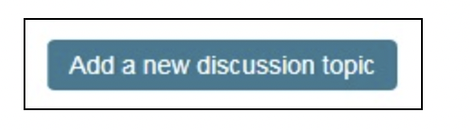
How to Use Discussion Boards
A forum is a way to have online discussions or share information with your instructor and classmates.
Posting a new topic to a forum:
1. Go to the course that has the forum you wish to access.
2. Select the Forum that you wish to add a discussion to then scroll down to Add a new discussion topic button at the bottom of the forum.

Slide 6
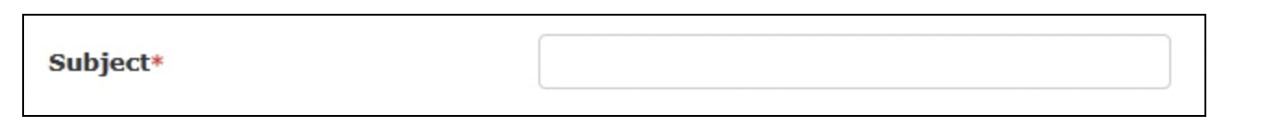
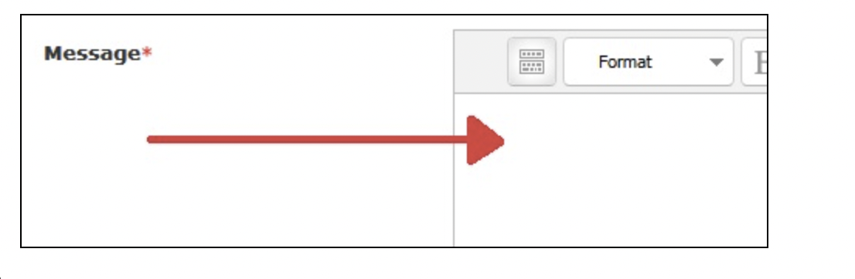
Give the topic a name in the Subject field.
Type your post in the Message section.

Slide 7
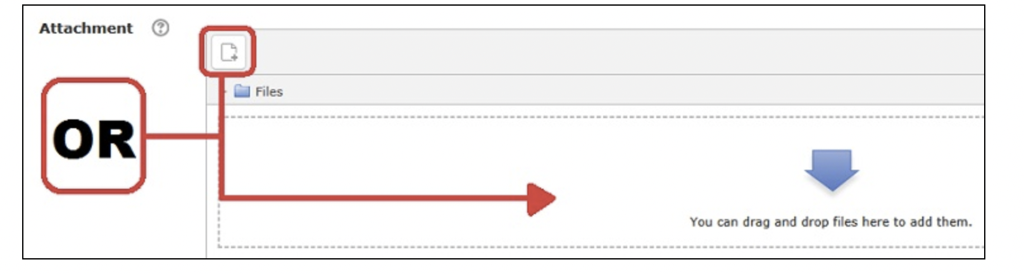
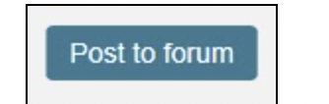
You can also upload a file to the forum.
.
Type your post in the Message section.
Check your post for errors then click the Post to forum button at the bottom. You will have 30 minutes to
edit your post after posting.

Slide 8


Be sure to change the Subscription setting to reflect your preference:
If you want to receive emails of every post to the forum, check the box next to Discussion subscription.
If not, uncheck the box.
Some instructors may have set the forum to force you to be subscribed or to not allow you to be subscribed, so these previous options will not appear.

Slide 9
Replying to a forum topic or question:
1. Click the name of the topic in the forum.
2. Click the Reply link at the bottom right of the post to which you want to reply.
3. Type your post in the Message section.
4. You can change whether you're subscribed to a given forum at any time by clicking the name of the forum, then clicking the Subscribe/Unsubscribe me from this forum link at the top right of the window
Some instructors may enable the Groups feature to divide forum participants into separate groups. If you want to see the forum posts for a particular group, select the group name from the drop-down menu that will appear on the forum's page. Depending on how the instructor configured the forum, you may be able to see only posts made by members of your group.

Slide 10
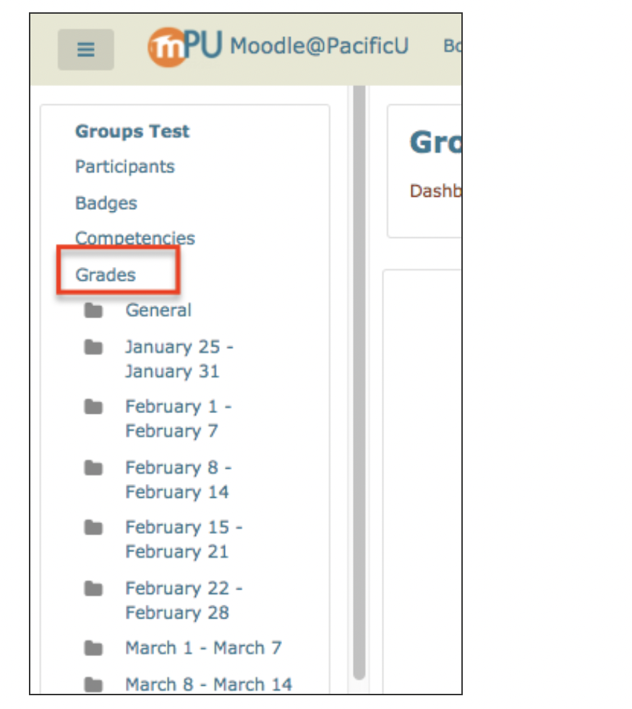
Viewing Grades
Log into your Moodle account.
Select the course you'd like to view grades for.
Once you’re on the course homepage, click on Grades on the left side of the page menu:

Slide 11
ASSIGNMENT#1
IN DISCUSSION BOARD WRITE ABOUT YOURSELF AND TAKE THE SCREENSHOT AND ATTACH YOUR FILE IN THE ASSIGNMENT FIELD

